Slide 1
AZ-900 Cloud Service Types
Ali Khawaja
Sr. Cloud Architect
Microsoft Arabia
Notes:
https://docs.microsoft.com/learn/paths/microsoft-azure-fundamentals-describe-cloud-concepts/

Slide 2

Cloud service types
Notes:
https://docs.microsoft.com/learn/modules/describe-cloud-service-types

Slide 3
Cloud Services - Objective Domain
Describe Infrastructure as a Service (IaaS)
Describe Platform as a Service (PaaS)
Describe Software as a Service (SaaS)
Identify appropriate use cases for each cloud service (IaaS, PaaS, SaaS)
Notes:
https://docs.microsoft.com/learn/modules/describe-cloud-service-types/1-introduction

Slide 4
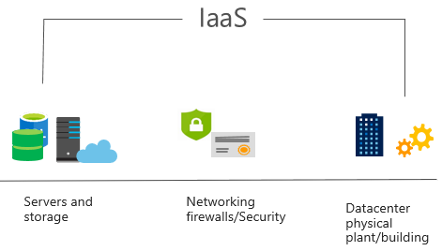
Infrastructure as a Service (IaaS)
Build pay-as-you-go IT infrastructure by renting servers, virtual machines, storage, networks, and operating systems from a cloud provider.
Notes:
https://docs.microsoft.com/learn/modules/describe-cloud-service-types/2-describe-infrastructure-service
For more information on IaaS, visit https://azure.microsoft.com/en-us/overview/what-is-iaas/
Most basic cloud computing services category.
Build pay-as-you-go IT infrastructure by renting servers, virtual machines, storage, networks, and operating systems from a cloud provider.
Instant computing infrastructure, provisioned and managed over the internet.

Slide 5
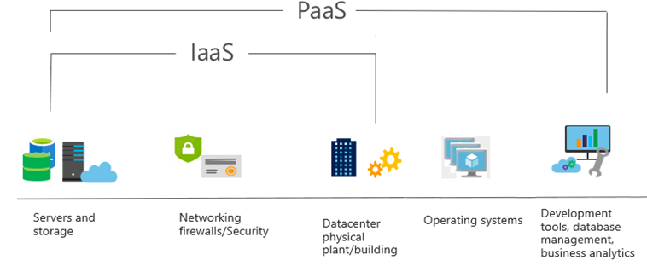
Platform as a Service (PaaS)
Provides environment for building, testing, and deploying software applications; without focusing on managing underlying infrastructure.
Notes:
https://docs.microsoft.com/learn/modules/describe-cloud-service-types/3-describe-platform-service
For more information on PaaS, see https://azure.microsoft.com/en-us/overview/what-is-paas/
Provides environment for building, testing, and deploying software applications.
Helps create applications quickly, without focusing on managing underlying infrastructure.

Slide 6
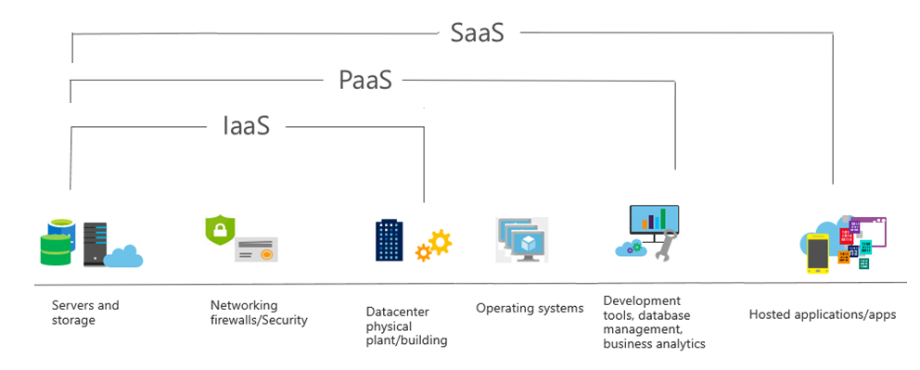
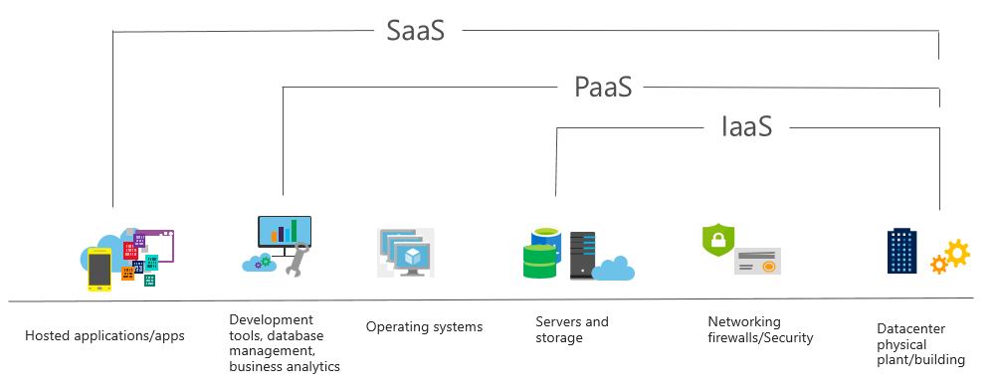
Software as a Service (SaaS)
Users connect to and use cloud-based apps over the internet: for example, Microsoft Office 365, email, and calendars.
Notes:
https://docs.microsoft.com/learn/modules/describe-cloud-service-types/4-describe-software-service
Common usage scenarios:
Examples of Microsoft SaaS services include Microsoft Office 365, Skype, and Microsoft Dynamics CRM Online.
For more information on SaaS, see https://azure.microsoft.com/en-us/overview/what-is-saas/

Slide 7
Cloud service comparison
IaaS
PaaS
SaaS
The most flexible cloud service.
Focus on application development.
Pay-as-you-go pricing model.
You configure and manage the hardware for your application.
Platform management is handled by the cloud provider.
Users pay for the software they use on a subscription model.

Slide 8

Learning Path 01 Review
The shared responsibility model
Public, private, and hybrid-cloud
Benefits of cloud computing
Cloud service types
Microsoft Learn Modules (docs.microsoft.com/Learn)

